Slide 1



Spring Data Code First
Introduction to Spring Data
Databases
Frameworks
SoftUni Team
Technical Trainers
Software University
http://softuni.bg

Slide 2

Table of Content
Spring Data
Repository
Services

Slide 3
Questions
sli.do #Hibernate

Slide 4

Spring Data

Slide 5


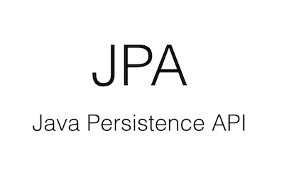


Spring Date
Extra layer of abstraction
Hibernate
+=
EclipseLink
JPA
Spring Data
TopLink

Slide 6
What is Spring Data
Powerful repository and custom object-mapping abstractions
Dynamic query derivation from repository method names
Implementation domain base classes providing basic properties
Support for transparent auditing (created, last changed)
Possibility to integrate custom repository code
Easy Spring integration via JavaConfig and custom XML namespaces
Experimental support for Advanced integration with Spring MVC controllers
cross-store persistence

Slide 7
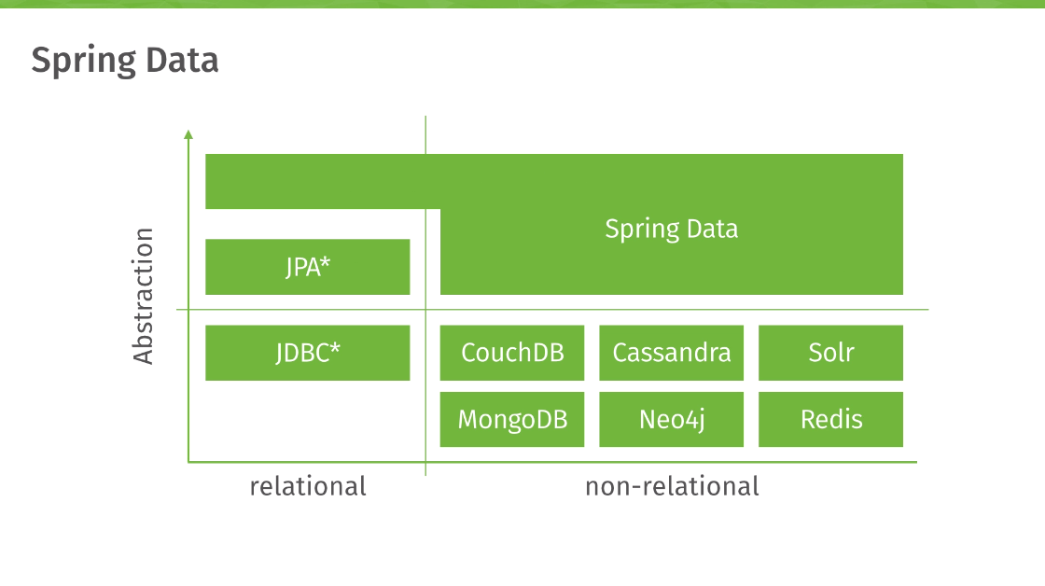
Spring Data Role

Slide 8
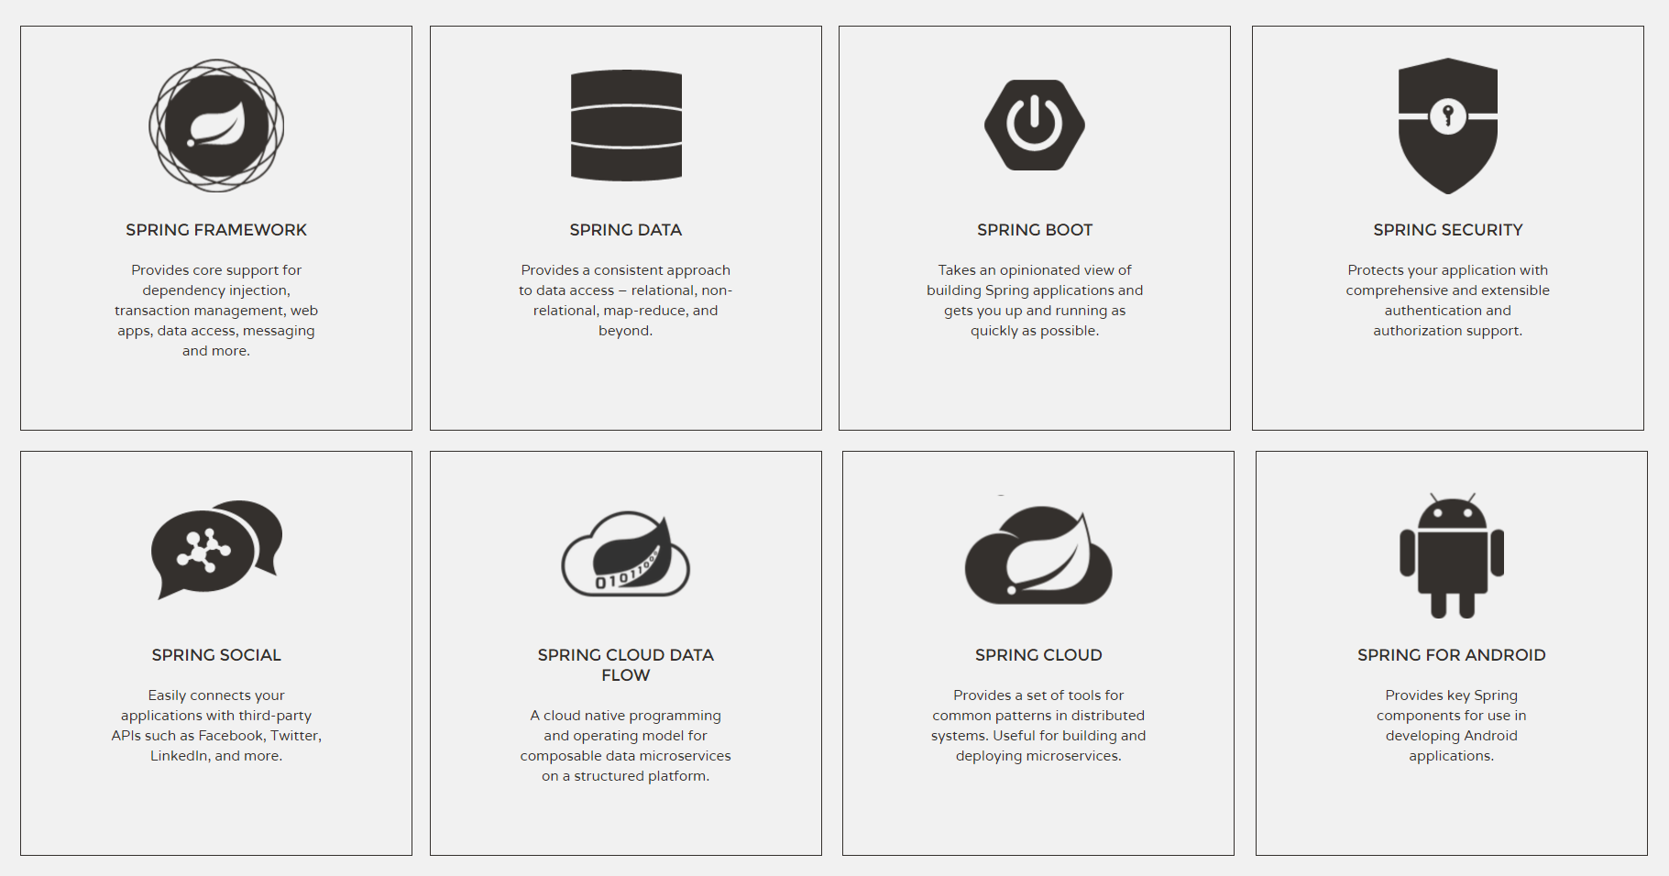
Spring Framework
Spring Data Module
Spring Boot Module

Slide 9
Spring Boot – Convention over configuration
Create stand-alone Spring applications
Embed Tomcat or Jetty directly (no need to deploy WAR files)
Provide opinionated 'starter' POMs to simplify your Maven configuration
Automatically configure Spring whenever possible
Absolutely no code generation and no requirement for XML configuration

Slide 10
Dependencies
pom.xml
Parent
<parent>
<groupId>org.springframework.boot</groupId>
<artifactId>spring-boot-starter-parent</artifactId>
<version>1.4.1.RELEASE</version>
</parent>

Slide 11
Dependencies
pom.xml
<dependencies>
<dependency>
<groupId>org.springframework.boot</groupId>
<artifactId>spring-boot-starter-data-jpa</artifactId>
</dependency>
<dependency>
<groupId>mysql</groupId>
<artifactId>mysql-connector-java</artifactId>
</dependency>
</dependencies>
Spring Data
MySQL Connector

Slide 12
Build
pom.xml
<build>
<plugins>
<plugin>
<groupId>org.apache.maven.plugins</groupId>
<artifactId>maven-compiler-plugin</artifactId>
<version>3.5.1</version>
<configuration>
<source>1.8</source>
<target>1.8</target>
</configuration>
</plugin>
</plugins>
</build>
Java compile version

Slide 13
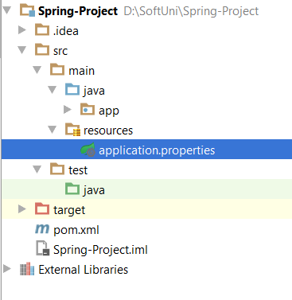
Configuration
Configuration file

Slide 14
Configuration
application.properties
#Data Source Properties
spring.datasource.driverClassName = com.mysql.jdbc.Driver
spring.datasource.url = jdbc:mysql://localhost:3306/school?useSSL=false
spring.datasource.username = root
spring.datasource.password = 1234
#JPA Properties
spring.jpa.properties.hibernate.dialect = org.hibernate.dialect.MySQL5InnoDBDialect
spring.jpa.properties.hibernate.format_sql = TRUE
spring.jpa.hibernate.ddl-auto = create-drop
Database Connection
JPA properties

Slide 15
Configuration
application.properties
###Logging Levels
# Disable the default loggers
logging.level.org = WARN
logging.level.blog = WARN
#Show SQL executed with parameter bindings
logging.level.org.hibernate.SQL = DEBUG
logging.level.org.hibernate.type.descriptor = TRACE
Loggin settings

Slide 16
spring.jpa.hibernate.ddl-auto
create – drop- drop the schema at the end of the session
create- creates the schema, destroying previous data
validate - validate the schema, makes no changes to the database
update - update the schema

Slide 17
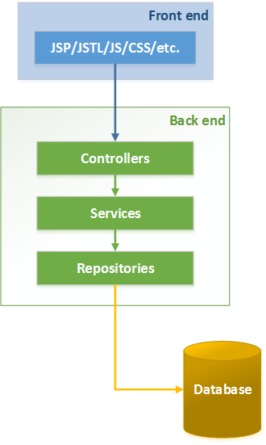
Spring Architecture
Course Scope

Slide 18
Spring Data Architecture
MODEL

Slide 19
Java Bean
The class must have a public default constructor (with no arguments). This allows easy instantiation within editing and activation frameworks.
The class properties must be accessible using get, set, is (can be used for boolean properties instead of get), and other methods (so-called accessor methods and mutator methods) according to a standard naming convention. This allows easy automated inspection and updating of bean state within frameworks, many of which include custom editors for various types of properties. Setters can have one or more than one argument.
The class should be serializable.

Slide 20
Models
Student.java
@Entity
@Table(name = "students")
public class Student implements Serializable{
@Id
@GeneratedValue(strategy = GenerationType.IDENTITY)
private long id;
@Column(name = "first_name")
private String firstName;
@Column(name = "registration_date")
private Date registrationDate;
@ManyToOne
@JoinColumn(name = "major_id")
private Major major;
public Student() {
}
}
Serializable
Column mapping
Empty Constructor

Slide 21
Models
Major.java
@Entity
@Table(name = "majors")
public class Major implements Serializable {
@Id
@GeneratedValue(strategy = GenerationType.IDENTITY)
private long id;
@Basic
private String name;
public Major() {
}
}
Serializable
Column mapping
Empty Constructor

Slide 22
Spring Data Architecture
MODEL REPOSITORY
JPA REPOSITORY
MODEL

Slide 23
Spring Repository
Abstraction to significantly reduce the amount of boilerplate code required to implement data access layers
Perform CRUD Operations
Automatically generates JPQL/SQL code
Highly customizable
Provides built-in database operations
Provides Query lookup strategies

Slide 24
Built-in CRUD Operations
<S extends T> S save(S var1);
<S extends T> Iterable<S> save(Iterable<S> var1);
T findOne(ID var1);
boolean exists(ID var1);
Iterable<T> findAll();
Iterable<T> findAll(Iterable<ID> var1);
long count();
void delete(ID var1);
void delete(T var1);
void delete(Iterable<? extends T> var1);
void deleteAll();
DATABASE
JPA REPOSITORY

Slide 25
Custom CRUD Operations
StudentDao.java
@Repository
public interface StudentDao extends CrudRepository<Student, Long> {
List<Student> findByMajorOrderByFirstNameAsc(Major major);
}
Custom method
SQL
SELECT s.*
FROM students AS s
INNER JOIN majors AS m
ON s.major_id = m.id
WHERE m.id = ?
ORDER BY s.first_name ASC

Slide 26
Query lookup strategies
Keyword | Sample | JPQL snippet
And | findByLastnameAndFirstname | … where x.lastname = ?1 and x.firstname = ?2
Or | findByLastnameOrFirstname | … where x.lastname = ?1 or x.firstname = ?2
Between | findByStartDateBetween | … where x.startDate between 1? and ?2
LessThan | findByAgeLessThan | … where x.age < ?1
Containing | findByFirstnameContaining | … where x.firstname like ?1 (parameter bound wrapped in %)
In | findByAgeIn(Collection<Age> ages) | … where x.age in ?1
Source: http://docs.spring.io/spring-data/jpa/docs/1.4.1.RELEASE/reference/html/jpa.repositories.html

Slide 27
Repositories
StudentDao.java
Repository
@Repository
public interface StudentDao extends CrudRepository<Student, Long> {
Student findById(long id);
List<Student> findAllByMajorOrderByFirstNameAsc(Major major);
void deleteByFirstName(String firstName);
}
Custom methods
MajorDao.java
Repository
@Repository
public interface MajorDao extends CrudRepository<Major, Long>{
List<Major> findTop10ByNameOrderByIdDesc(String name);
}
Custom methods

Slide 28
Spring Data Architecture
SERVICE IMPLEMENTATION
SERVICE
MODEL REPOSITORY
JPA REPOSITORY
MODEL

Slide 29
Services
StudentService.java
public interface StudentService {
void register(Student student);
void expel(Student student);
void expel(long id);
Student findStudent(long id);
List<Student> findSampleByMajor(Major major);
}
Business Logic

Slide 30
Services
StudentServiceImpl.java
@Service
public class StudentServiceImpl implements StudentService{
@Autowired
private StudentDao studentDao;
@Override
public void register(Student student) {
studentDao.save(student);
}
@Override
public void expel(Student student) {
studentDao.delete(student);
}
// The rest is omitted
}
Service Implementation
studentDao injection
Method implementation

Slide 31
Spring Annotations
@Component - marks a java class as a bean so the component-scanning mechanism of spring can pick it up and pull it into the application context
@Repository - specialization of the @Component annotation with similar use and functionality. It also makes the unchecked exceptions (thrown from DAO methods) eligible for translation into Spring DataAccessException
@Service – the annotation is also a specialization of the @Component annotation. it specifies the intent better.

Slide 32
Entry Point
MainApplication.java
@SpringBootApplication
public class MainApplication {
public static void main(String[] args) {
SpringApplication.run(MainApplication.class,args);
}
}
Spring Boot Entry Point

Slide 33
Command Line Runner
CommandLineRunner.java
Component
@Component
public class ConsoleRunner implements CommandLineRunner {
@Autowired
private StudentService studentService;
@Autowired
private MajorService majorService;
@Override
public void run(String... strings) throws Exception {
Major major = new Major("Java DB Fundamentals");
Student student = new Student("John",new Date(), major);
majorService.create(major);
studentService.register(student);
}
}
Student service
Major service
Persist data

Slide 34

Summary
Spring Data
Repository
Services

Slide 35










JDBC
https://softuni.bg/courses/

Slide 36
SoftUni Diamond Partners

Slide 37
License
This course (slides, examples, demos, videos, homework, etc.) is licensed under the "Creative Commons Attribution-NonCommercial-ShareAlike 4.0 International" license
Attribution: this work may contain portions from
"Databases" course by Telerik Academy under CC-BY-NC-SA license

Slide 38





Free Trainings @ Software University
Software University Foundation – softuni.org
Software University – High-Quality Education, Profession and Job for Software Developers
softuni.bg
Software University @ Facebook
facebook.com/SoftwareUniversity
Software University @ YouTube
youtube.com/SoftwareUniversity
Software University Forums – forum.softuni.bg

